Slide 1
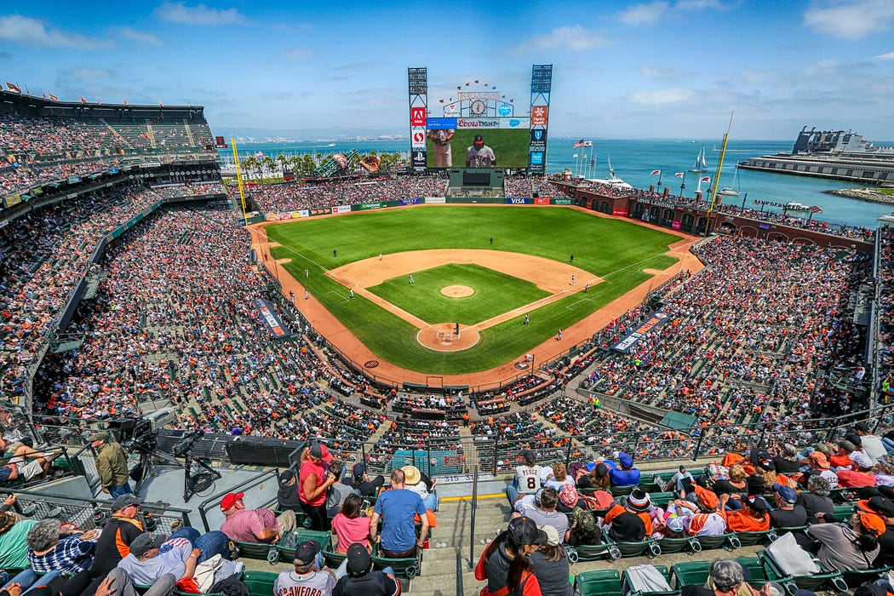

Predicting 2023 MLB Playoff Teams and mlb DIVISON realignment
Graham Jaeger
Adolfo Linarez
Nelson Linarez
Lamin Barrow
Anna Garcia

Slide 2

Introduction
Predicting
Predicting MLB Postseason Contenders
Using
Using Machine Learning and Hyperparameter Tuning
Presenting
Presenting a code-driven solution for predicting MLB postseason contenders based on team performance data.

Slide 3

Project Objectives
To determine which Major League Baseball teams would make it to the playoffs.
Develop an optimized neural network model for predictive analysis
Visualization and Interpretation of Major League Baseball Data
Analysis of Machine Learning model
Presenting a code-driven solution for optimizing the divisional alignment of sports teams to minimize travel distances.

Slide 4
Major League Baseball DATASET
Dataset Description: 2015 - 2022
Variables and Features - Home Runs, At Bats, Stolen Bases, Defensive Efficiency, Earned Runs etc.
Data Source: baseball-reference.com

Slide 5
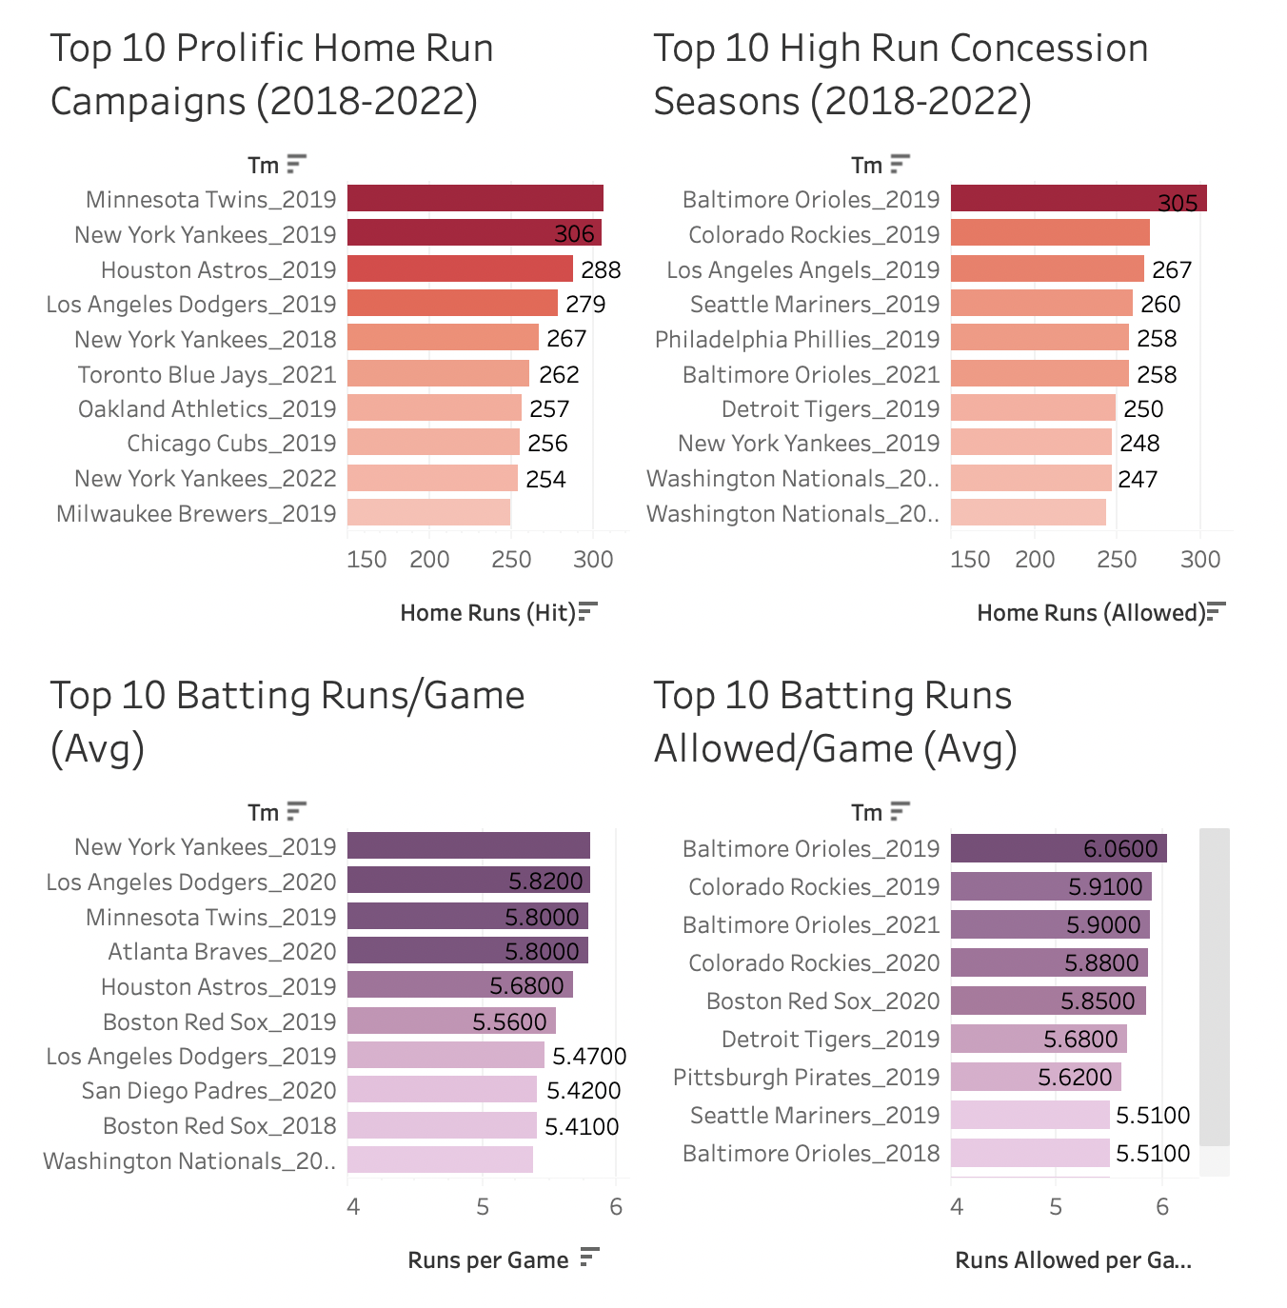
EXPLORATORY DATA ANALYSIS
Best Team Batting and Pitching Campaigns
Trends

Slide 6
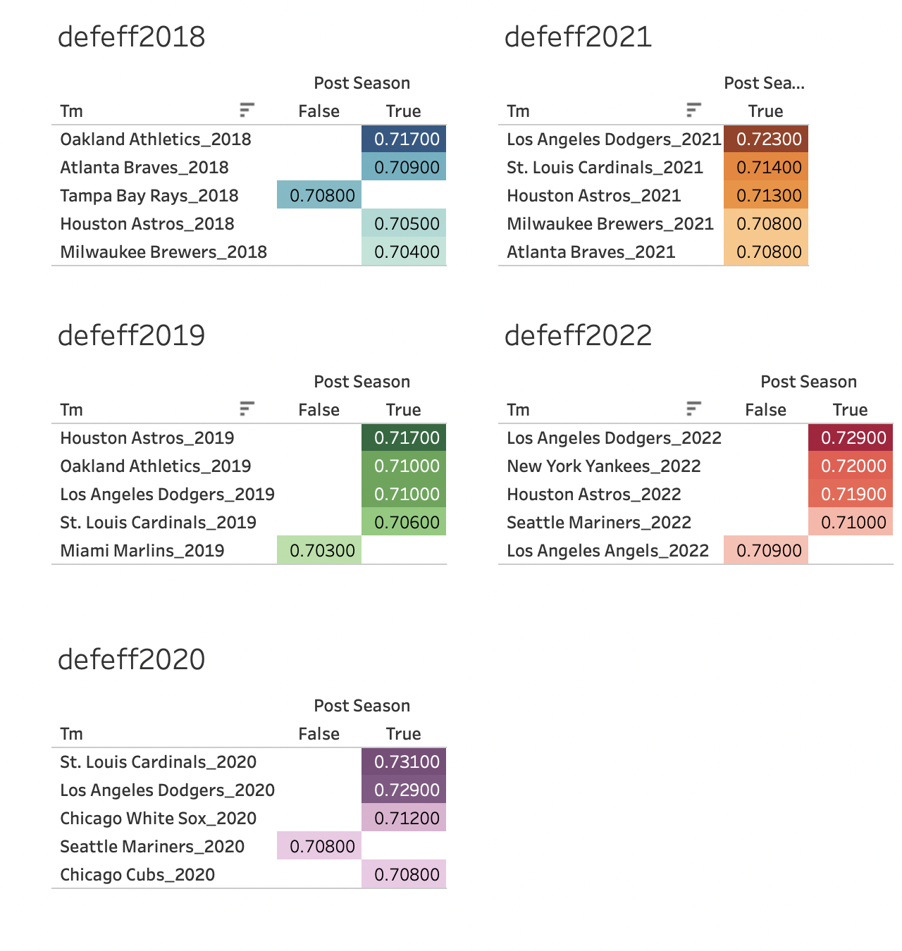
EXPLORATORY DATA ANALYSIS
Correlation of Defensive Efficiency on Post Season Play-off Qualification
Trends

Slide 7
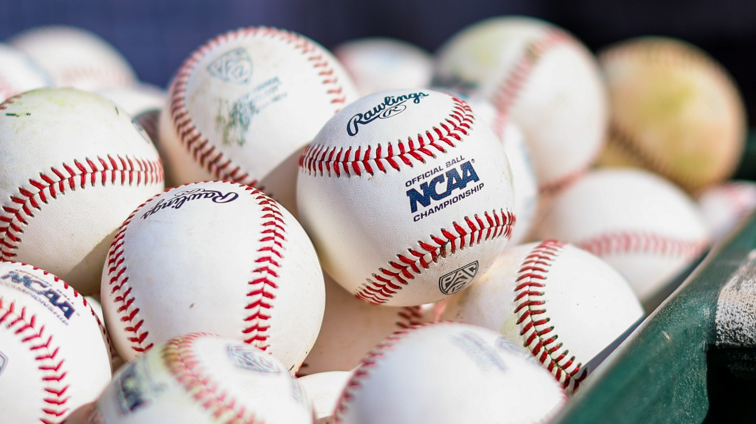
Feature Engineering
Feature Selection
01
Process of feature engineering - Transformations and new variables created.
02
Importance of selecting meaningful features for accurate predictions.
03
Lagged Variables
1. Player batting average
2. Pitcher earned run average
04

Slide 8

Neural Network Model - TRAINING AND EVALUATION
Overview of the neural network model used for the predictive element: TensorFlow and Keras for building a neural network.
Architecture and key components of the model.
Model Structure:
Output Layer: A single neuron for binary classification.
Activation Functions:
Hidden Layers: ReLU (Rectified Linear Unit) activation for non-linearity.
Output Layer: Sigmoid activation for probability output.
Layers and Neurons:
The number of hidden layers and neurons is determined dynamically by the Keras Tuner.
Hyperparameter tuning explores various configurations to optimize model performance.
This adaptability allows the model to capture complex patterns in the data effectively.

Slide 9

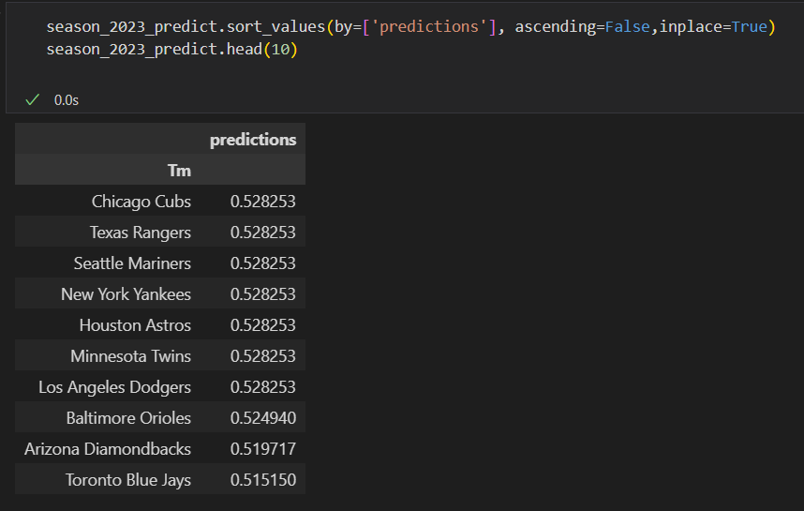










Predictive Performance
(Model performance in predicting 2023 MLB playoff Teams)

Slide 10

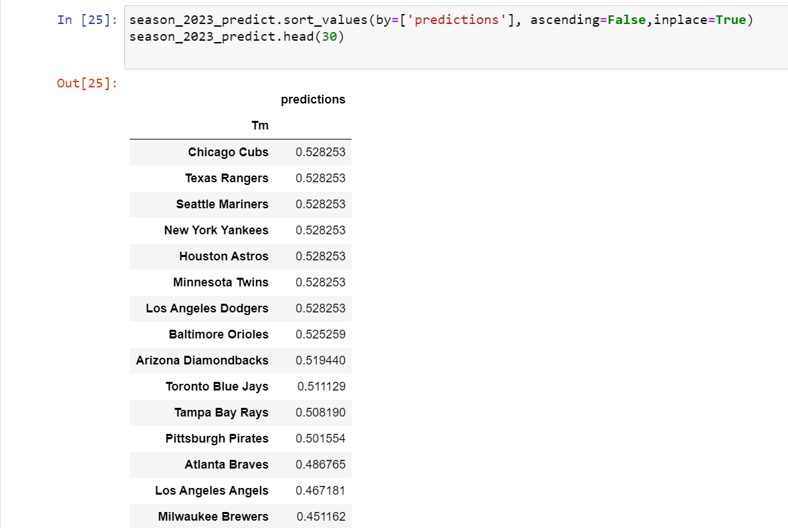
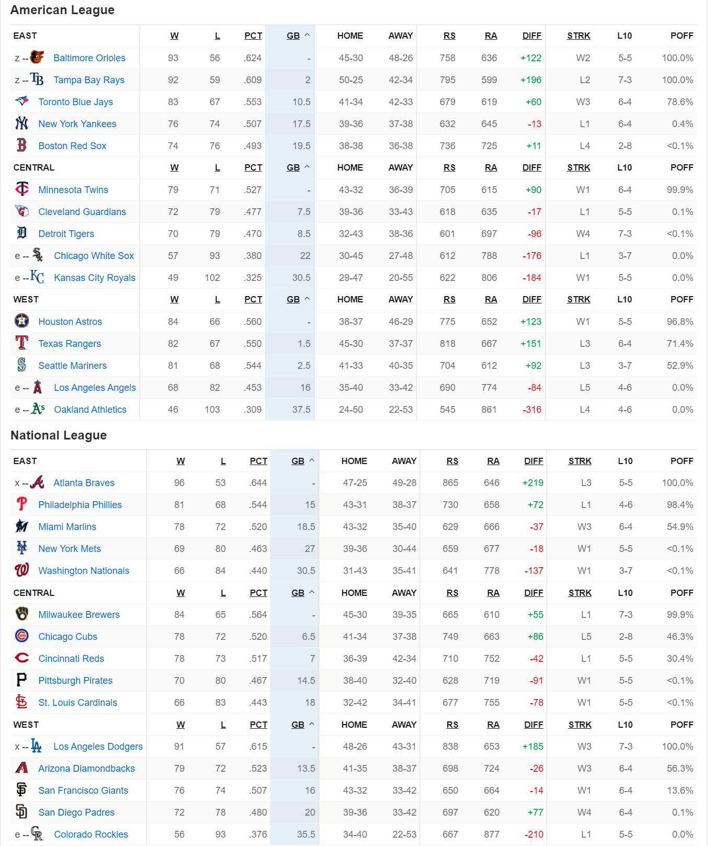



Predictive Performance
Model performance in predicting 2023 MLB playoff Teams
American League Teams
Current MLB Standings
national League Teams

Slide 11
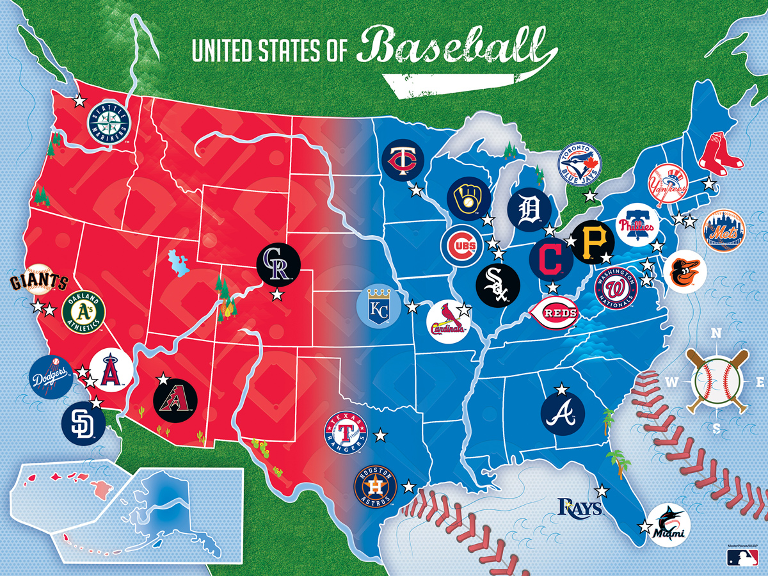
MLB Division Realignment

Slide 12
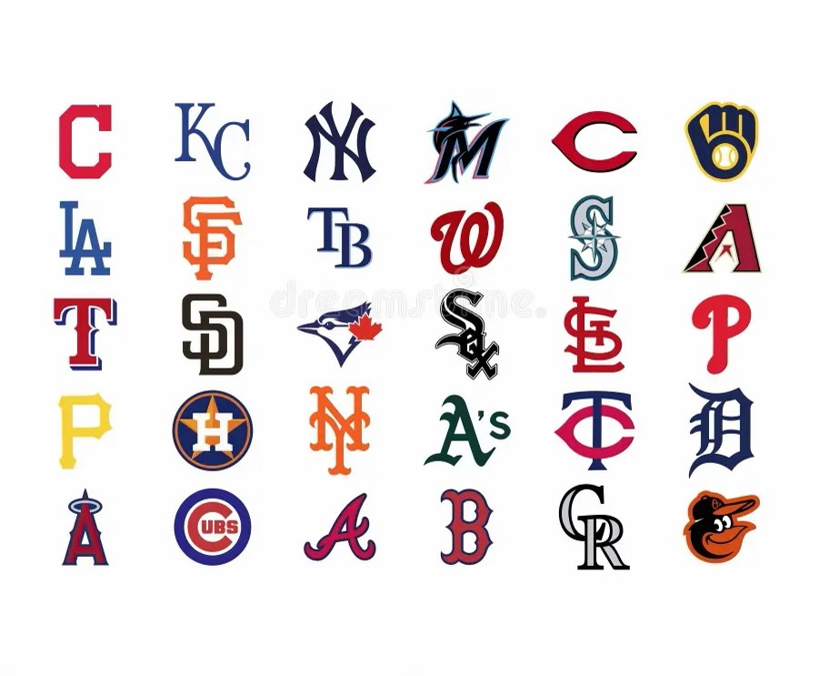
Presenting a code-driven solution for optimizing the divisional alignment of sports teams to minimize travel distances.
Beginning in 2023, teams play a balanced schedule as follows: they play their 13 games against their four divisional opponents (52 games), six or seven games against the other ten teams in their own league (64 games), four games against one "geographic rival" from the other league and three games against the other 14 teams from the other league for 46 total interleague games.

Slide 13

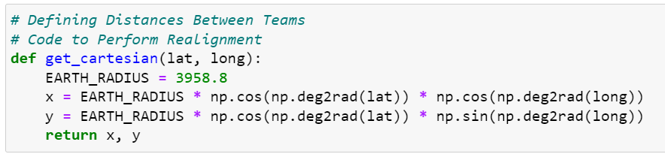
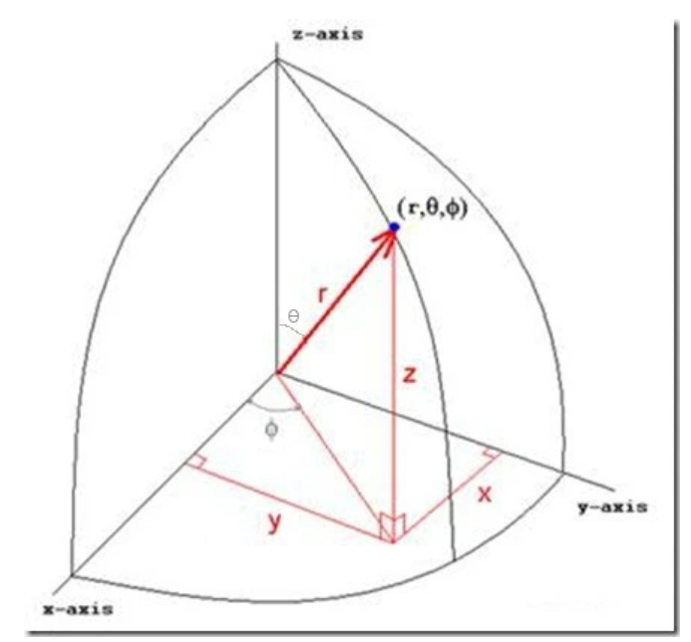
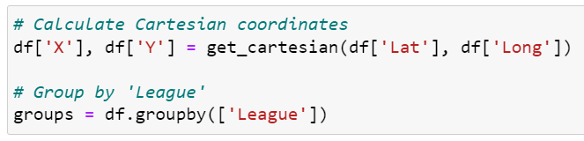
Data Preparation
Data Sources: dataset (stadiums.csv) containing team locations.
Coordinate Transformation: The algorithm implementation we are using relies on Euclidean distance as defined in the Cartesian coordinate system.
Haversine formula

Slide 14
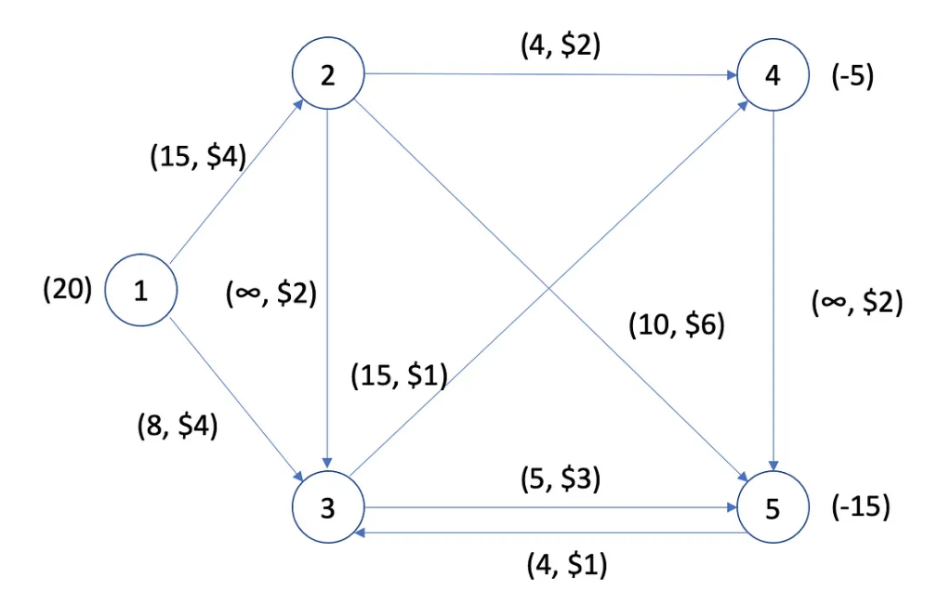
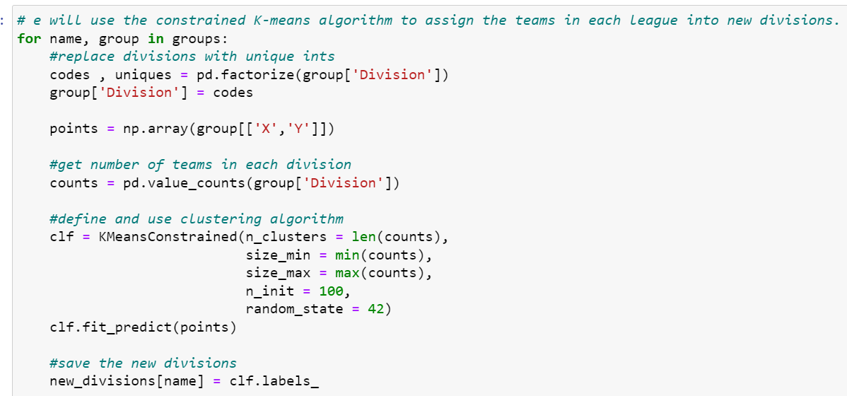
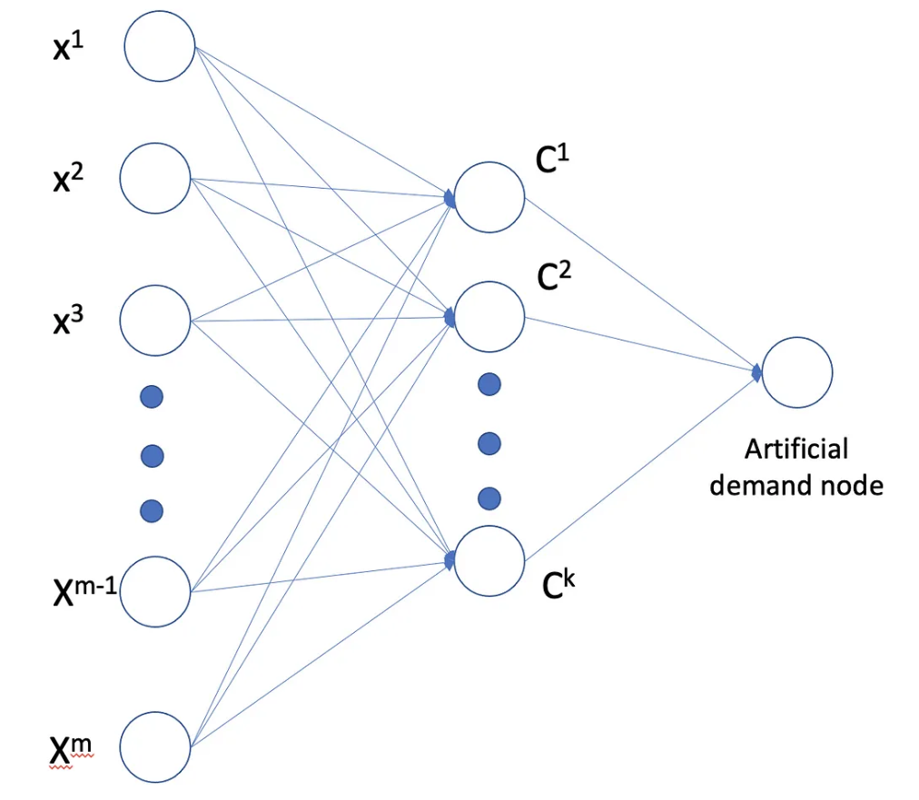
Division Realignment Algorithm
K-Means Constrained: K-Means Constrained algorithm by Joshua Levy-Kramer.
Methodology: Sports divisions are all approximately the same size and the standard K-means algorithm makes no guarantees that the resulting clusters will have this property

Slide 15
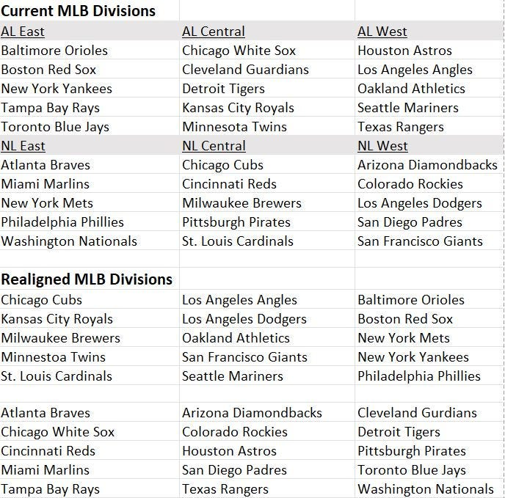
Division Realignment Results
League-wise Realignment: Showing the original and realigned divisions for each league.

Slide 16
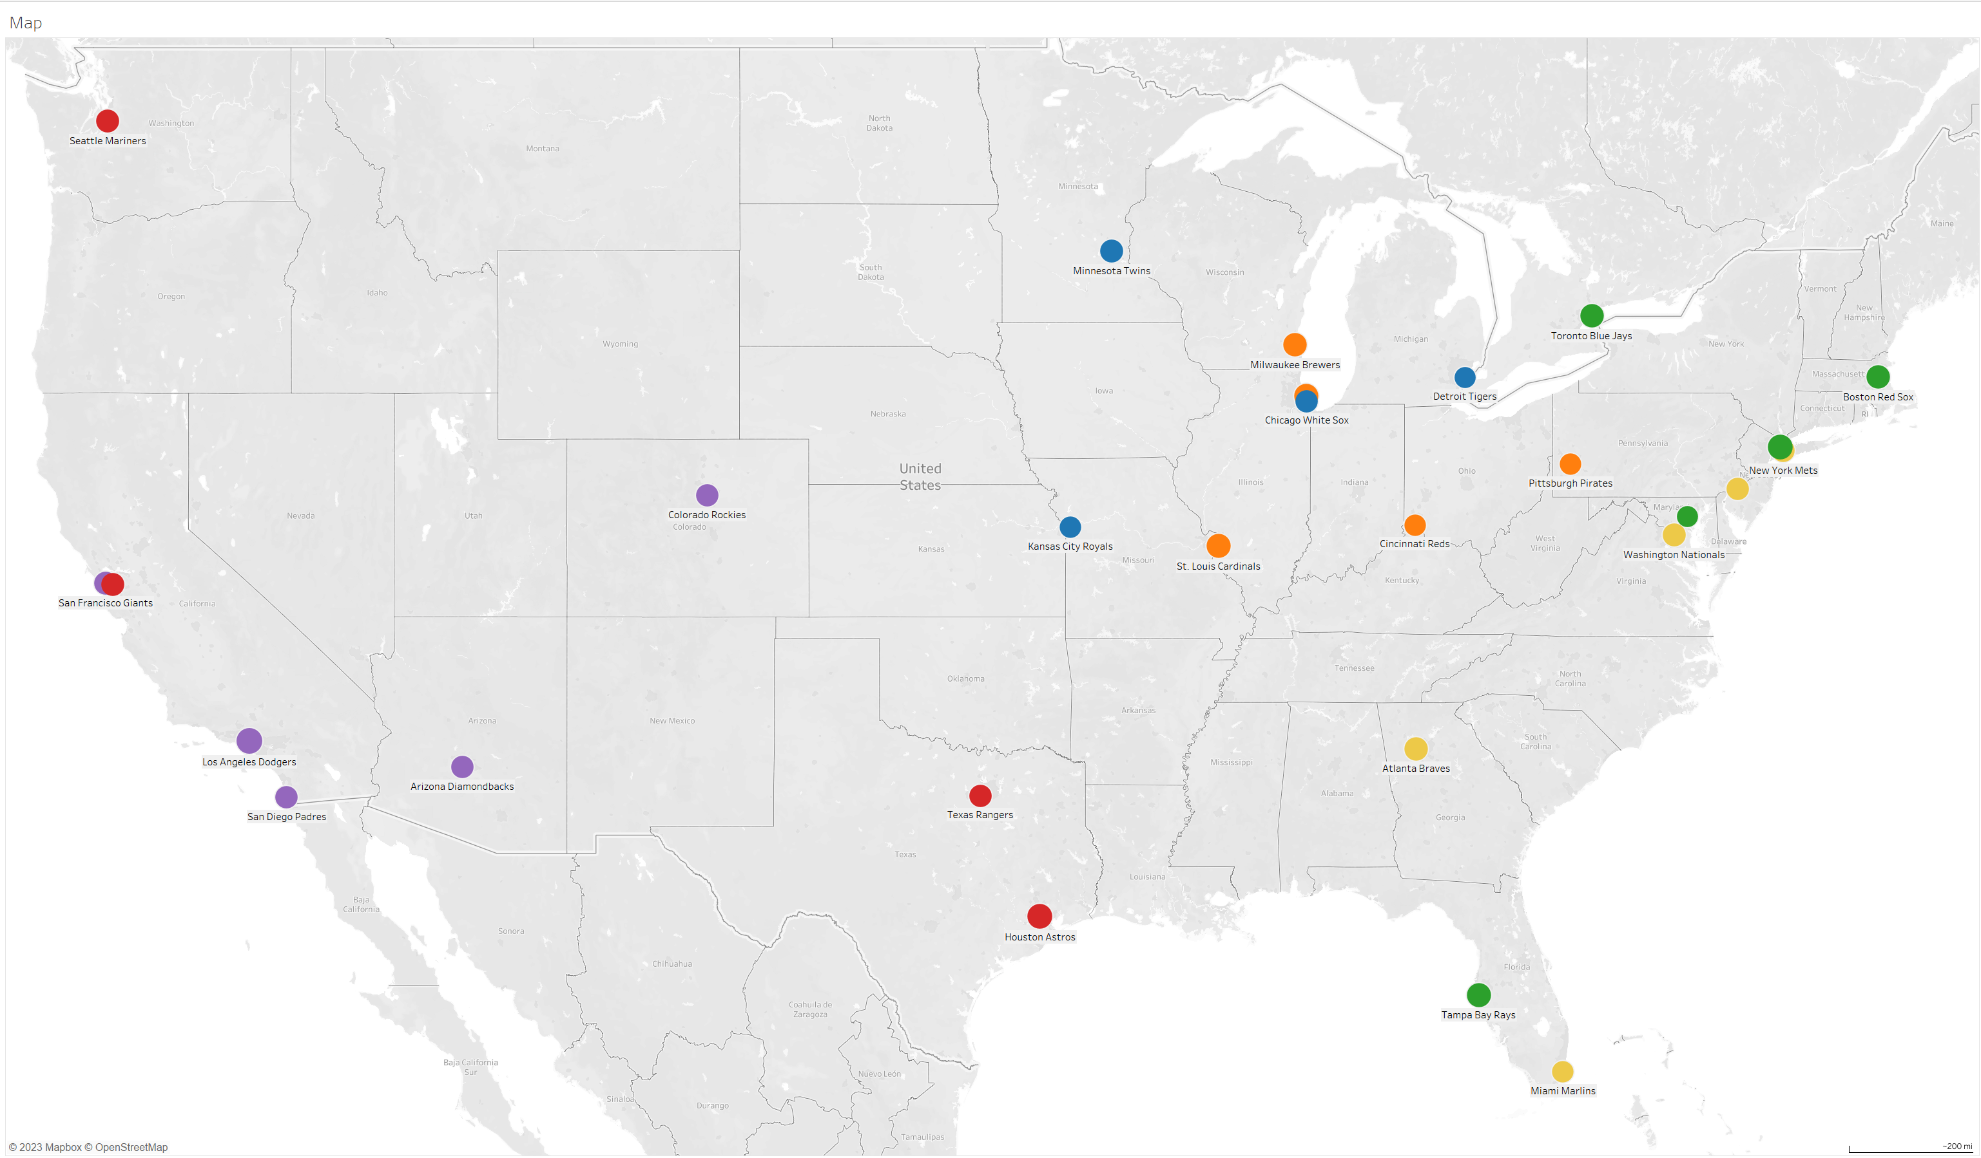
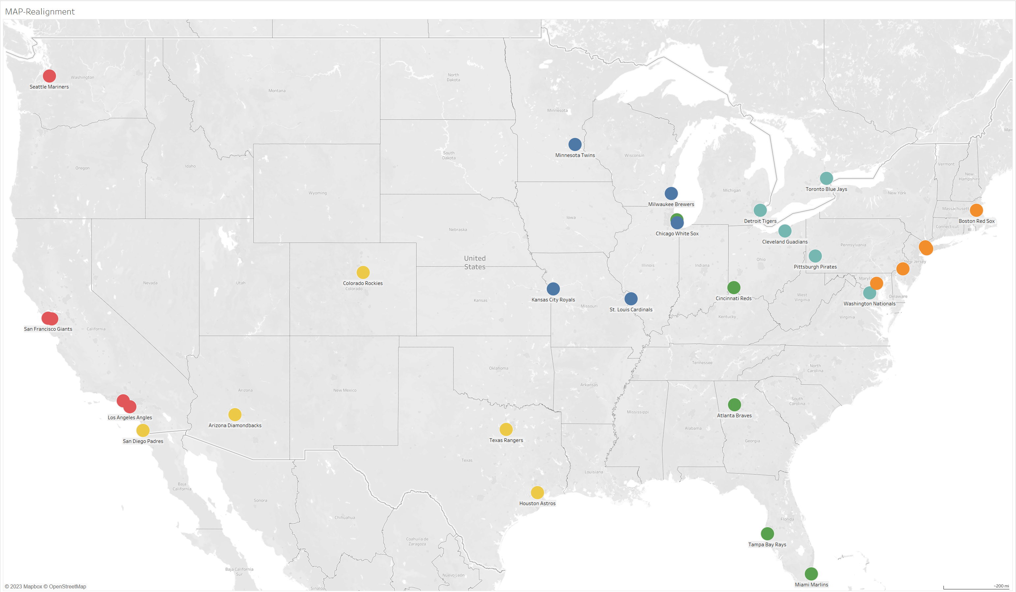
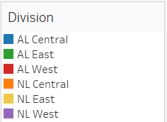
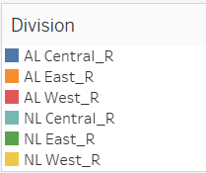
Visualizing Realignment
Plotly Visualization: Displaying Scattergeo plots for the original and realigned divisions.
Comparison: Visualizing the geographical changes in team distribution.

Slide 17

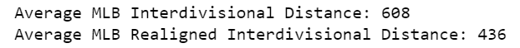
Evaluating Travel Distance Improvement
Average Distances: Presenting the average interdivisional distances before and after realignment.
Travel distance reduce in 28%

Slide 18
LIMITATIONS AND FUTURE WORK
Limitations or challenges encountered during the project
Areas for improvement and future research
Additional data sources - Enhance the accuracy of predictions

Slide 19


Questions & Answers

